Slide 1

Python Work-shop
Make Sure You have python installed for this session!

Slide 2
1 Setting Up Your Environment
There are many different Integrated Development Environments (IDE’s) available for working in python.
IDLE is the standard one that comes with the distribution of python, and what the university generally uses.
E.G. Spyder, Visual Studio Code, PyCharm
Create a new python file, naming it something relevant such as “devsocWkshp” and have it ready!

Slide 3
2.1 Planning What To Code
For this workshop we will be making a Rock, Paper, Scissors game.
What does it need to do?
Get an input from the user (Rock, Paper or Scissors)
Generate a random choice for the PC
Figure out who the winner is
Tell the user who won

Slide 4
2.2 Mapping It Out - Flowcharts
Flowcharts are an excellent way to visually plan out your code.
They are made using different shaped blocks to represent different things, and arrows to show the program flow.
Pseudocode is another good alternative, which involves writing out the code in a simplified form as plain text.
Start
Get user choice
Lose Message
Stop
No
User Won?
Generate PC choice
Win Message
Yes

Slide 5
3.1.1 The Variables
Variables are named placeholders for values that can be treated like the value itself
In python there is no command to create a variable, rather it is created as soon as a value is assigned to it
All variables have a data type, which depends on the value that has been input into it
In other languages (such as C++) you have to declare the variables data type when creating the variable

Slide 6
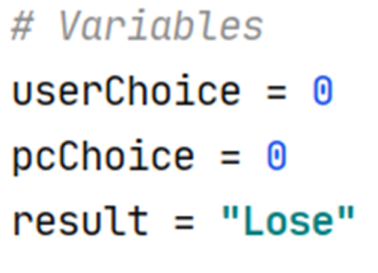
3.1.2 The Variables – Data Types
For this we need 3 variables:
Data Type | Example
str | x = “Hello World”
int | x = 20
float | x = 20.5
list | x = ["apple", "banana", "cherry"]
tuple | x = ("apple", "banana", "cherry")
bool | x = True
Notes:
# Variables
userChoice = 0
pcChoice = 0
result = "Lose"

Slide 7
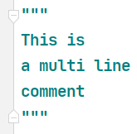
An Aside: Commenting
Commenting is a way of leaving yourself (and others) messages in your code.
Comments need to be relevant and consistent.
They are also useful for testing your code.

Slide 8
3.2 User Input
User Input is taken using the input function
Converts the input to an integer (all inputs are strings)
Assigns the input
value to the
userChoice variable
input function
Outputs the contained message before
taking the user unput
Notes:
# Get user choice
userChoice = int(input("Rock(1), Paper(2), Scissors(3)? "))

Slide 9
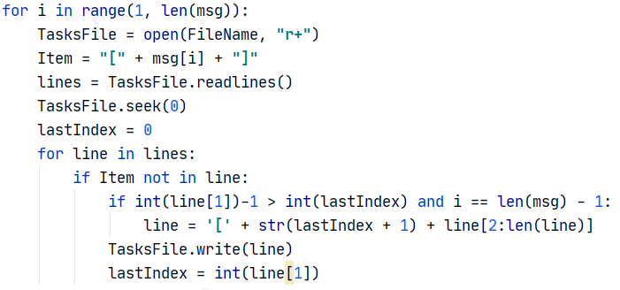
An Aside: Indentation
Indentation is generally done using the tab key and is a way of showing defining containers.
Notes:
In this case, what the code does doesn’t matter – its about the indentation

Slide 10

3.3 Random Library
Most distributions of python automatically include the random library, but it needs to be imported into your code
Libraries are external files containing additional functions, many are included in python but some need to be installed through Pip
You can even write your own and access them in your code
I would recommend researching more about libraries in the future, however all you need to know for now is:
Notes:
Always put imports at the top of your code
# Imports library for generating random
import random

Slide 11

3.4 Generating a Random Integer
With the random library imported, can use the randint function
randint parameters
1 = minimum
3 = maximum
returns a value
1 <= n <= 3
Sets pcChoice value to the random number
Referencing the library
randint function
Notes:
# Generating PC choice
pcChoice = random.randint(1, 3)
print("PC chose", pcChoice)

Slide 12

3.5.1 Whose The Winner? - Draw
To figure out the winner we need to use an if statement
If statements work exactly how they sound; if x then y!
Comparison
Operator
Conditional statement
Indentation
If condition is True: Execute all indented below
Notes:
# Figuring out the winner
# Draw condition
if userChoice == pcChoice:
result = "Draw"

Slide 13
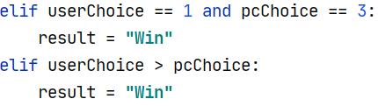
3.5.2 Whose The Winner? Player Win
We can use elif to extend the if statement to cover the player’s win conditions.
Elif is a way of saying "if the previous condition(s) weren’t true, then try this condition“
It acts the same as the if statement, but only executes if the previous if/elif statements in the chain aren’t true
User | PC | Result
1 | 3 | Win
2 | 1 | Win
3 | 2 | Win
Notes:
# Win Condition elif userChoice == 1 and pcChoice == 3: result = "Win" elif userChoice > pcChoice: result = "Win"

Slide 14

3.5.3 Whose The Winner? Player Loss
As we have covered the win and draw conditions, anything else would be a player loss
This means you can just use else, which ends the if statement
Notes:
# Lose Condition else: result = "Lose"

Slide 15
3.6 Concluding the Program
To top off the program, we can add the final message to output the result:
Notes:
# Output Result print("Game Over, you " + result + "!")

Slide 16
4 Extension Tasks & Questions Time
Have the PC’s choice be output as the actual name e.g. PC chose Scissors
Can be done either with an if statement, or, more simply, a list
Adding validation to the user input (making sure the user inputs a integer between 1 and 3)
Suggest using the type() function and an if statement
Use a while loop to keep asking for an input until you get a valid one
Give the user the option to play again
Using a while loop and an if statement
Notes:
https://www.w3schools.com/python/python_lists.asp
https://www.w3schools.com/python/python_while_loops.asp
https://www.w3schools.com/python/python_datatypes.asp

Slide 17
Thanks For Coming
Email me(N0853071@my.ntu.ac.uk) or ping me on the DevSoc discord (@Jad) if you need any more help

